Slide 1


“Job Application Tracker using Greedy Match”
CSA0303- Data Structures
Presented By:
SUVEDHAN G (192524381)
G.HARI PRASAD (192525273)
JASHWANTH.G.R (192524384)
Guided by: Dr. T. RAJESH KUMAR

Slide 2
INTRODUCTION
Job Application Tracker using Greedy Match
Automates candidate screening, ranking, and interview scheduling for recruiters.
Uses Greedy algorithms to make the locally optimal choice at every hiring stage.
Matches applicant skills to job requirements with a computed score.
Improves speed, fairness, and efficiency of the recruitment pipeline.

Slide 3
PROBLEM STATEMENT
THE CHALLENGE
Manual resume screening is slow and inconsistent across recruiters.
Interview slots are often double-booked or scheduled inefficiently.
Large applicant pools make it hard to shortlist fairly and quickly.
Recruiters need a fast, rule-based system, not a complex optimizer.
A Greedy-based tracker can solve this with simple, fast decisions.

Slide 4
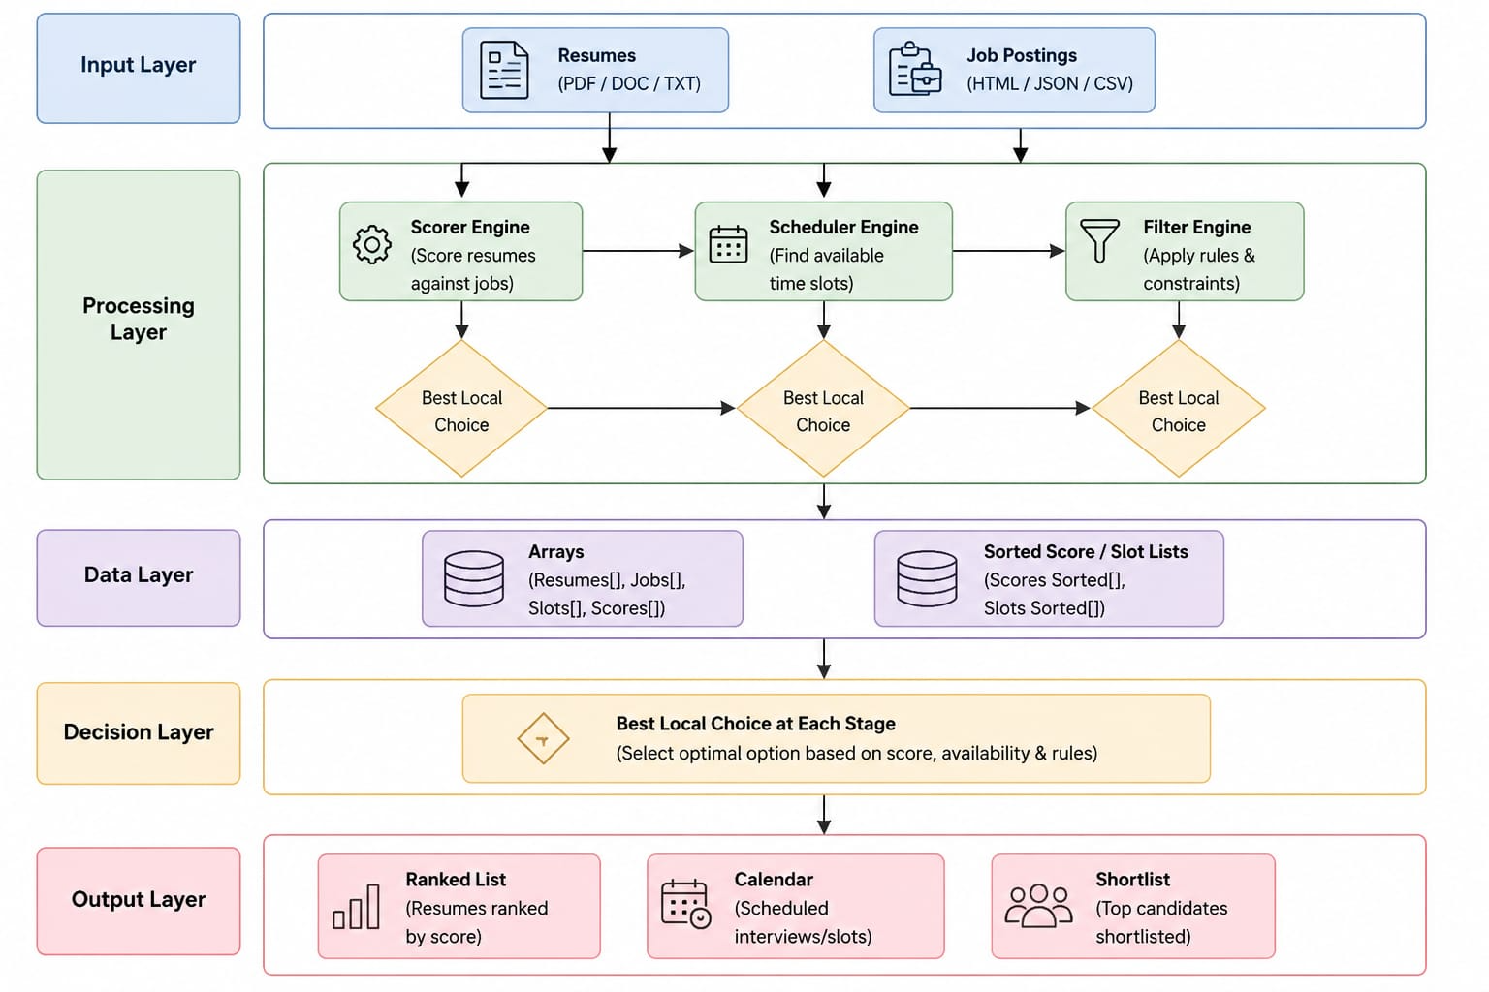
System Architecture
Input Layer: resumes and job postings.
Processing Layer: Scorer, Scheduler, Filter engines.
Data Layer: arrays and sorted score/slot lists.
Decision Layer: best local choice at each stage.
Output Layer: ranked list, calendar, and shortlist.

Slide 5
Project Modules
Three Core Modules
Module 1 - Candidate-Job Skill Scorer: ranks applicants by Match Score.
Module 2 - Interview Scheduling Optimizer: allocates conflict-free slots.
Module 3 - Recruitment Funnel Filter: shortlists top-tier candidates.
Each module applies a Greedy strategy at its own stage of hiring.
Together they form one end-to-end recruitment pipeline.

Slide 6
MODULE 1: Skill Scorer
Ranking Applicants by Relevance
Match applicant skill sets against job requirements.
Calculate a Match Score (0-100%) for each candidate.
Apply Greedy Approach: highest-scoring candidates first.
Generate a ranked list from most to least qualified.
Instantly flag top candidates for recruiter review.

Slide 7
MODULE 2:
Interview Scheduling Optimizer
Time-Slot Allocation Tool
Assigns interview slots based on recruiter availability.
Uses Greedy Interval Scheduling to pick earliest slots.
Sorts requests by finish time to avoid overlaps.
Maximizes the number of interviews per day.
Produces a fully packed, conflict-free calendar.

Slide 8
MODULE 3:
Recruitment Funnel Filter
Selects the top-N candidates above the score threshold.
Makes locally optimal choices at each stage.
Filters resumes, tests, and interviews in sequence.
Rapidly narrows a large pool to top-tier talent.
Passes only top-ranked candidates to the next stage.

Slide 9
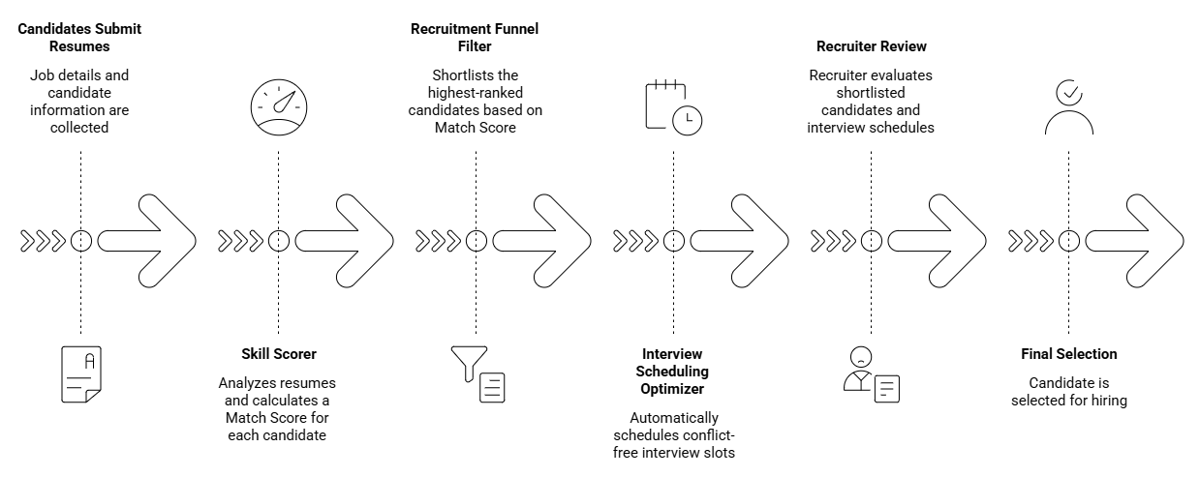
Workflow

Slide 10
Techniques & Data Structures Used
Greedy Approach (Max-Score First) for skill scoring.
Greedy Interval Scheduling for interview slot allocation.
Greedy Filtering for funnel-based shortlisting.
Arrays / Sorting to rank candidates by score or time.
Priority Queue to always access the top-ranked candidate.

Slide 11
Advantages
Rapid and simple candidate matching.
Efficient interview scheduling with no time conflicts.
Faster shortlisting for high-volume recruitment drives.
Easy to implement and extend with new criteria.

Slide 12
Conclusion
The Job Application Tracker automates end-to-end recruitment decisions.
It ranks candidates, schedules interviews, and filters applicants using Greedy strategies.
It reduces recruiter workload and speeds up hiring.
It is fast, simple, and easy to scale to real-world hiring volumes.
Greedy algorithms make the system practical and easy to maintain.

Slide 13
THANK YOU

